Slide 1
Deep learning – Convolutional neural networks
Michael S. Ryoo
Several slides from R. Fergus, S. Lazebnik, J.-B. Huang, and Y. J. Lee

Slide 2
Announcements
Final exam - May 2nd 2:45-4:45pm (Info W107)
Programming assignment due May 4th
Course online evaluation

Slide 3

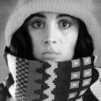

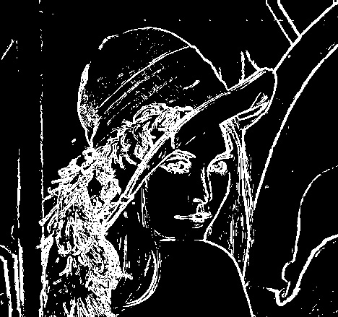
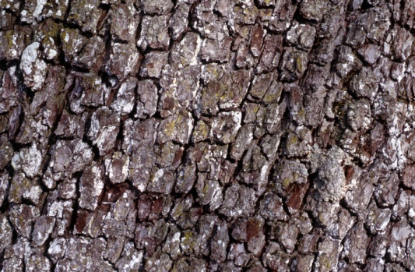

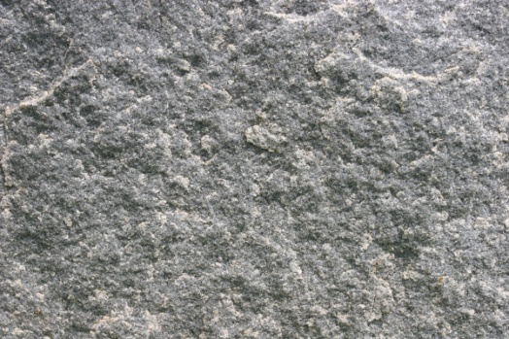
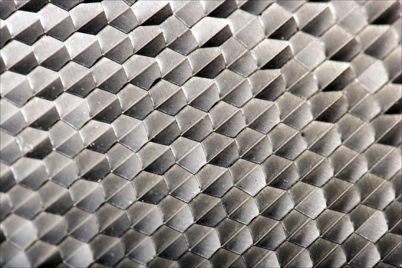
Recap: Features and filters
Transforming and describing images; textures, colors, edges
Kristen Grauman

Slide 4
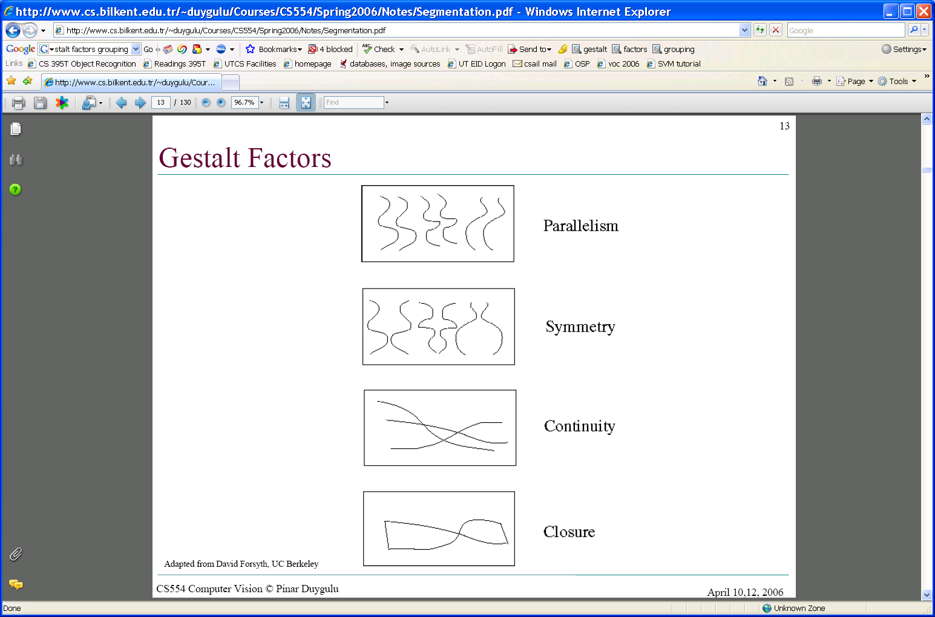
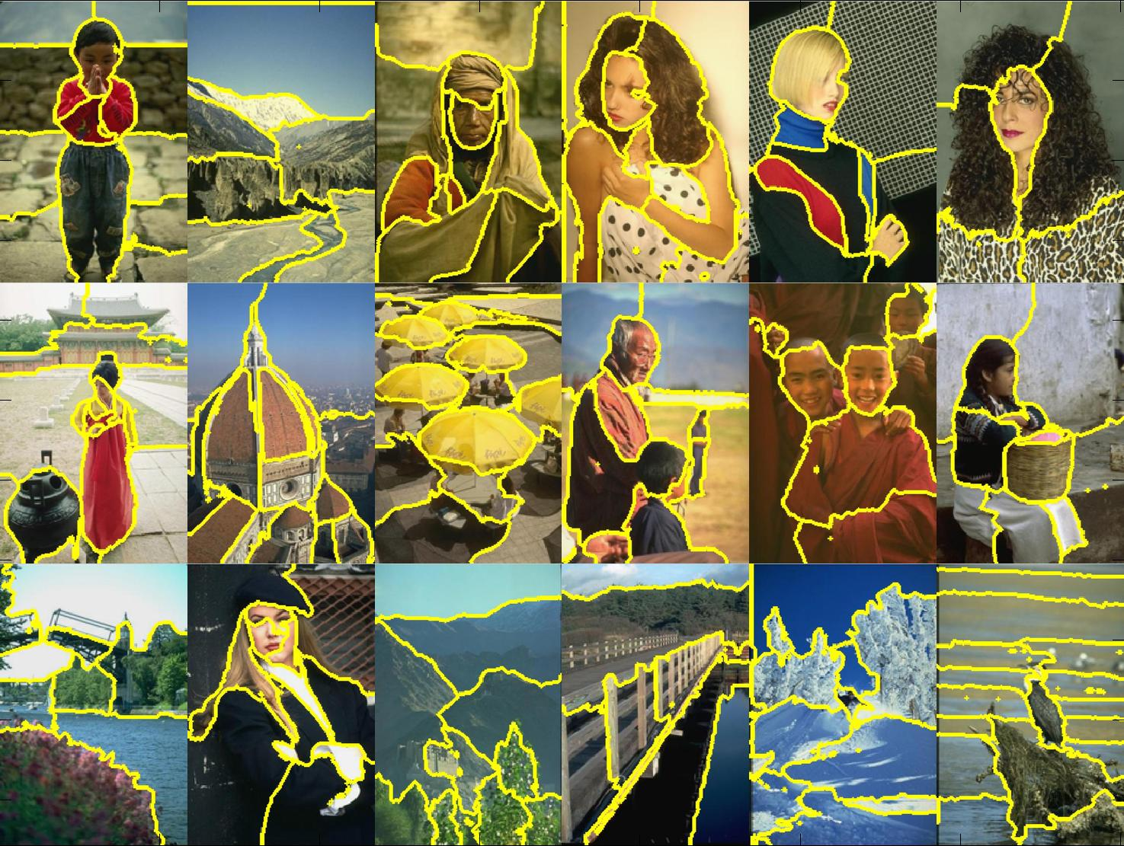
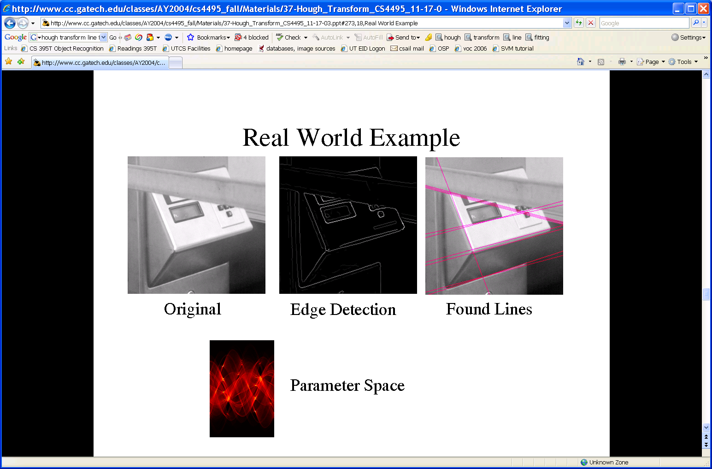
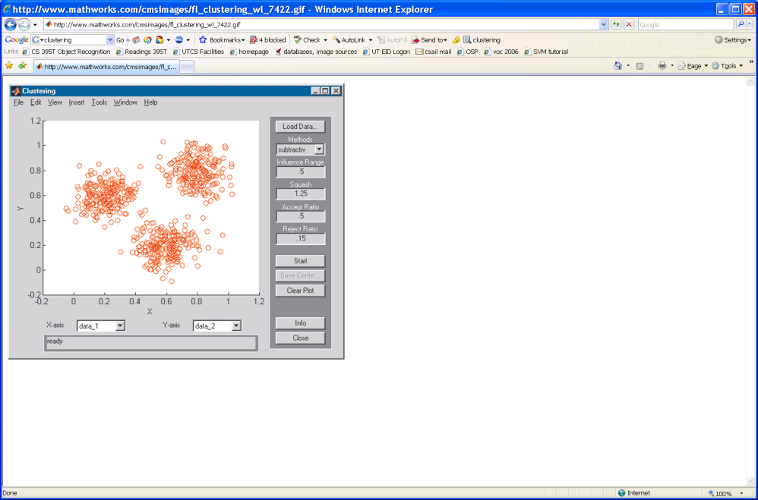
Recap: Grouping & fitting
Clustering, segmentation, fitting; what parts belong together?
[fig from Shi et al]
Kristen Grauman

Slide 5
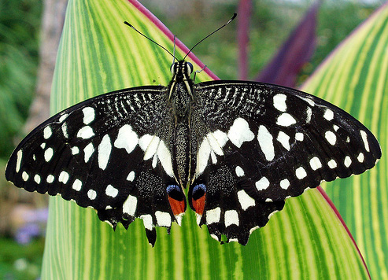
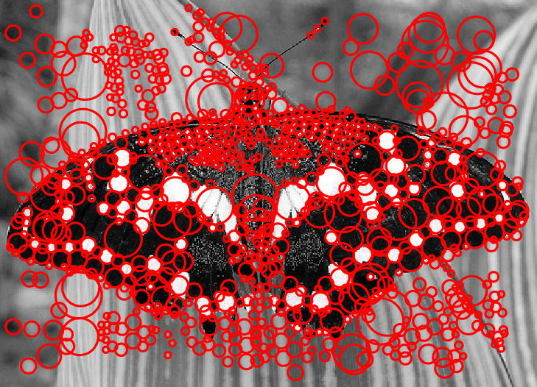
Local features
Image credit: Lana Lazebnik

Slide 6
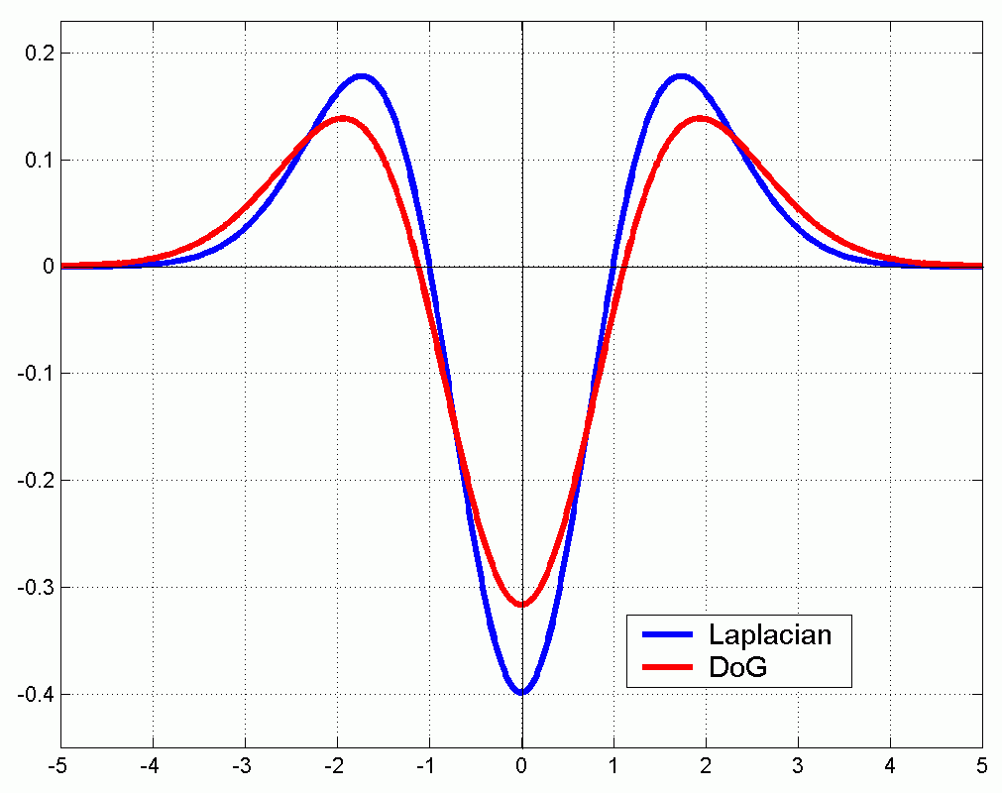
Approximating the Laplacian
We can approximate the Laplacian with a difference of Gaussians; more efficient to implement.
(Laplacian)
(Difference of Gaussians)

Slide 7
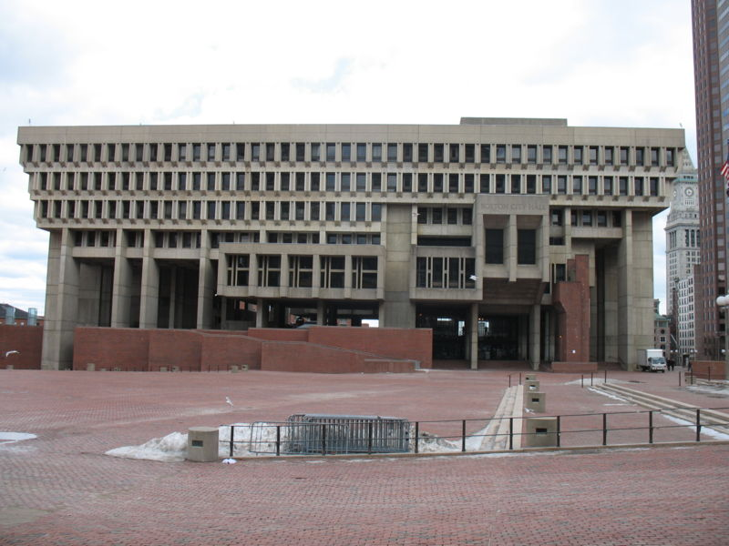
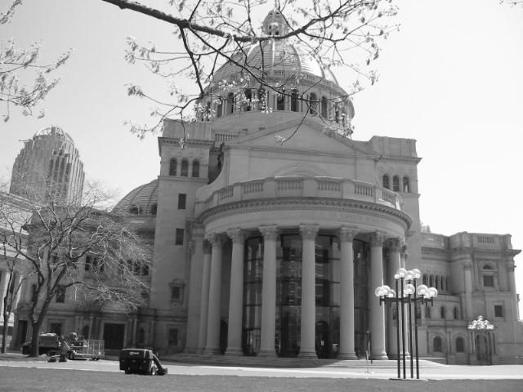
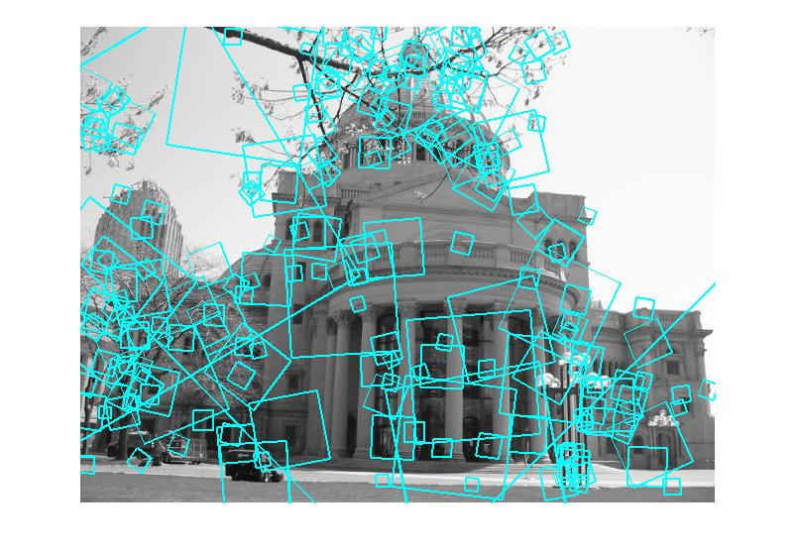
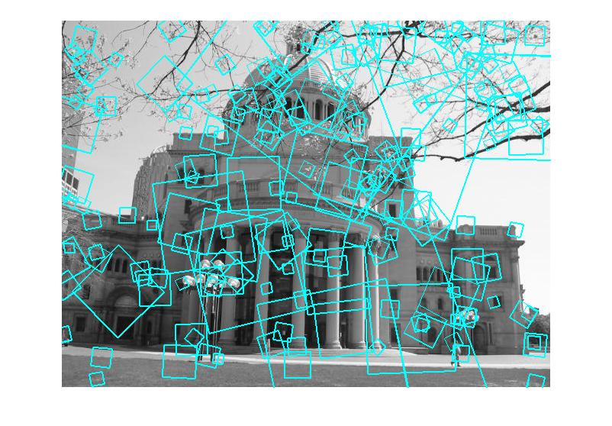
Indexing local features
…
Kristen Grauman

Slide 8
Visual words
Map high-dimensional descriptors to tokens/words by quantizing the feature space
Quantize via clustering, let cluster centers be the prototype “words”
Word #2
Determine which word to assign to each new image region by finding the closest cluster center.
Descriptor’s feature space
Kristen Grauman

Slide 9
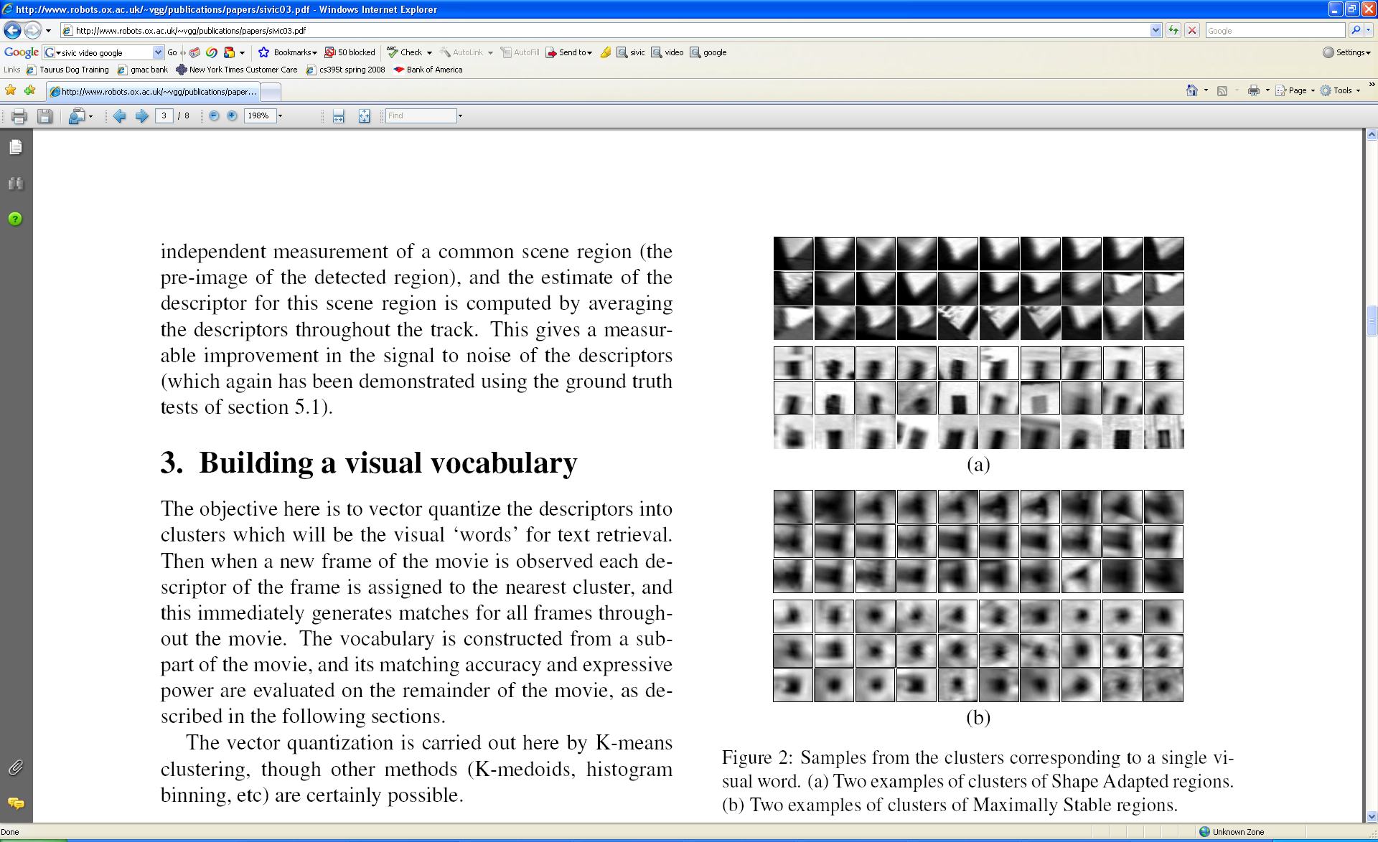
Visual words
Example: each group of patches belongs to the same visual word
Figure from Sivic & Zisserman, ICCV 2003
Kristen Grauman

Slide 10
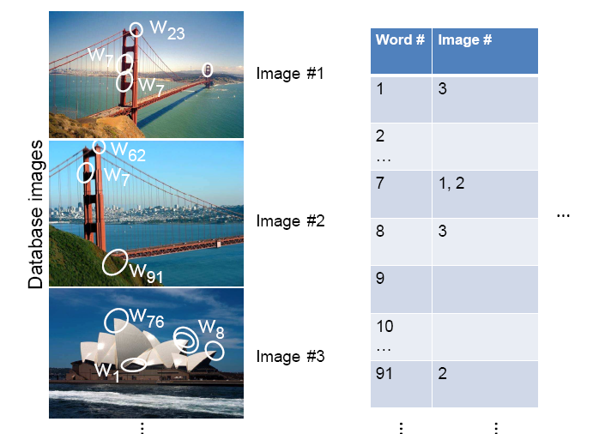
Inverted file index
Database images are loaded into the index mapping words to image numbers
Kristen Grauman

Slide 11
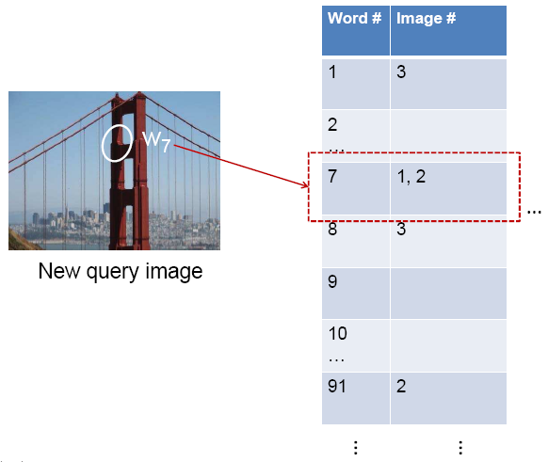
Inverted file index
When will this give us a significant gain in efficiency?
New query image is mapped to indices of database images that share a word.
Kristen Grauman

Slide 12
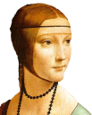
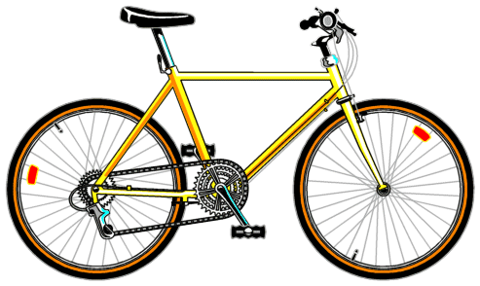
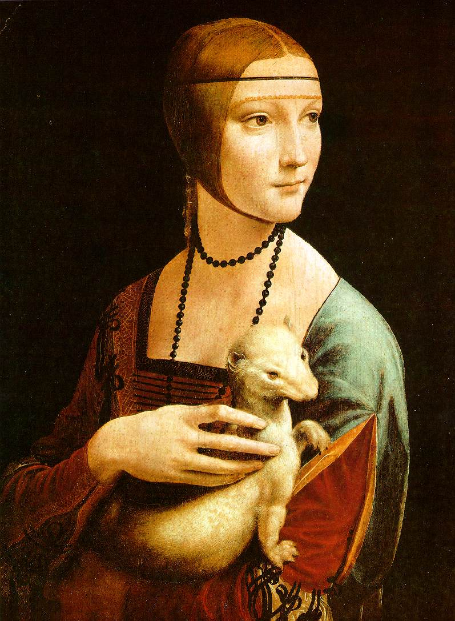
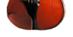

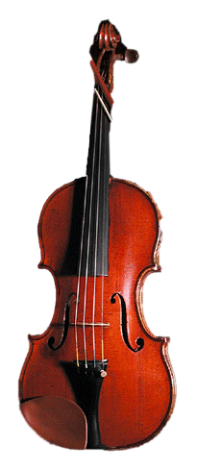
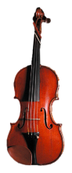

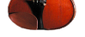

Bags of visual words
Summarize entire image based on its distribution (histogram) of word occurrences.
Analogous to bag of words representation commonly used for documents.
Notes:
12

Slide 13
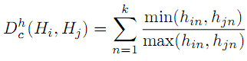
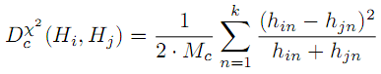

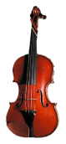



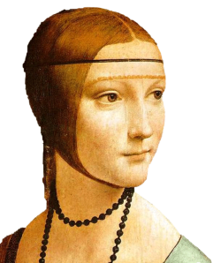
Comparing bags of words
Multiple different types of ‘kernels’ can be used to measure the ‘distance’ between histograms --nearest neighbor search for similar images.
[1 8 1 4]
[5 1 1 0]
for vocabulary of k words
Notes:
(possibly weighted)
Cosine similarity

Slide 14
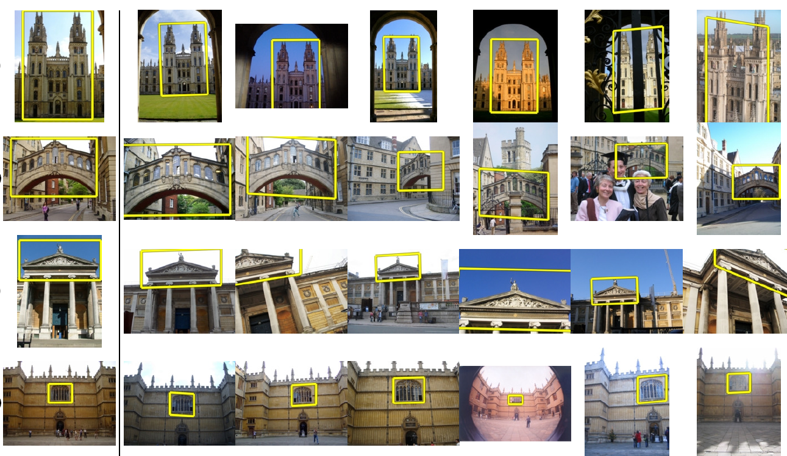
Application: Large-Scale Retrieval
Query
Results from 5k Flickr images (demo available for 100k set)
[Philbin CVPR’07]

Slide 15
Spatial Verification: two basic strategies
RANSAC
Typically sort by BoW similarity as initial filter
Verify by checking support (inliers) for possible transformations
e.g., “success” if find a transformation with > N inlier correspondences
Generalized Hough Transform
Let each matched feature cast a vote on location, scale, orientation of the model object
Verify parameters with enough votes
Kristen Grauman

Slide 16
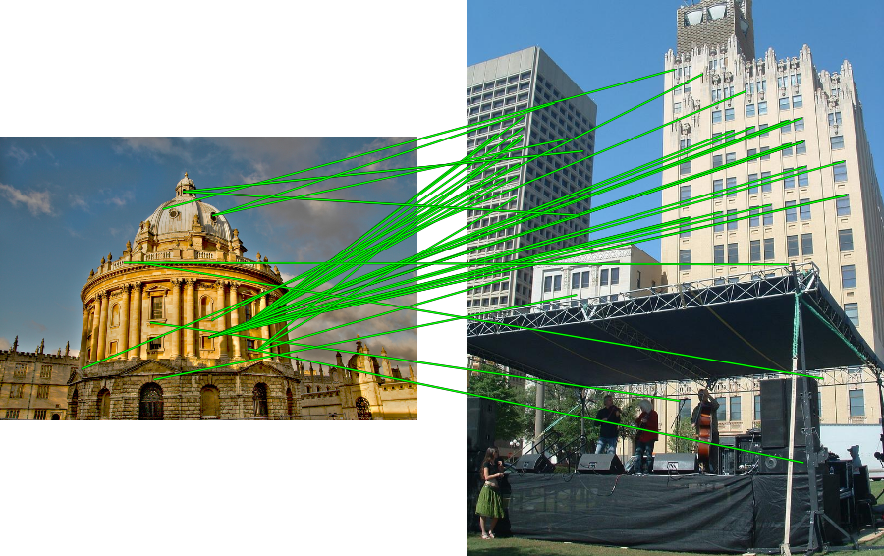
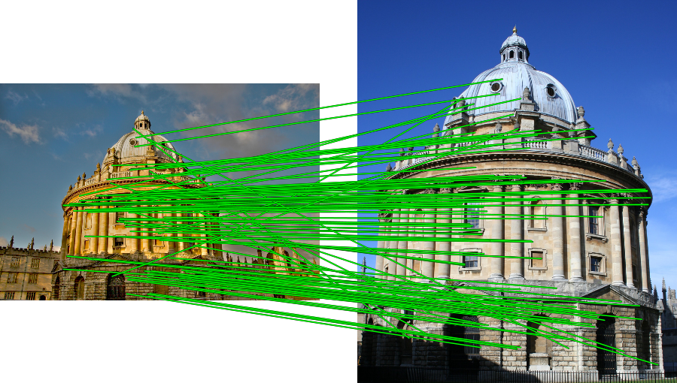
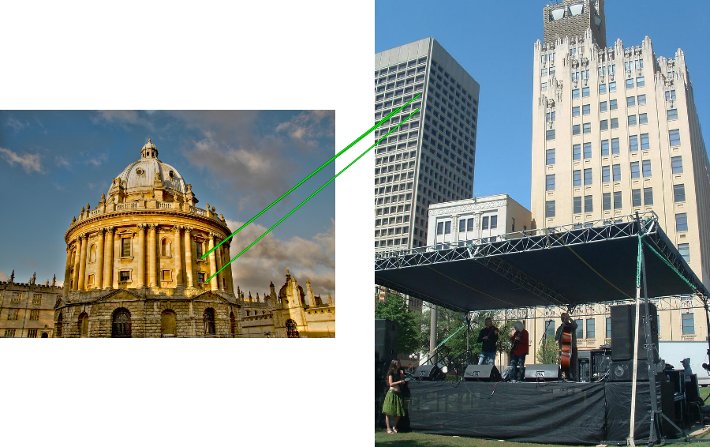
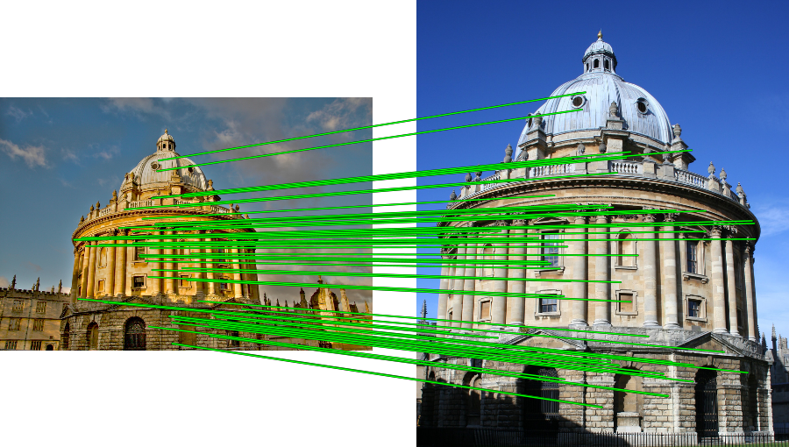
RANSAC verification

Slide 17
Overview
Background
Convolutional Neural Networks (CNNs)
Understanding and Visualizing CNNs
Applications
Packages

Slide 18

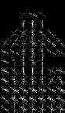
Conventional classification framework
Image data
Semantic labels
Representation
Feature extraction
Human 0.9 Not-human 0.1
Classifier
n-D data (e.g., n = 320*240)
s labels (e.g., s = 2)
k-D vector (e.g., 1000)
18

Slide 19
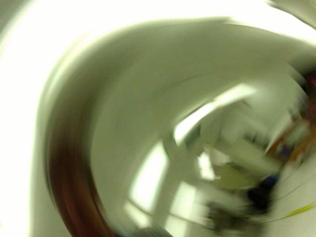
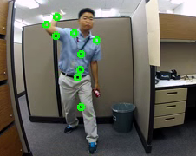
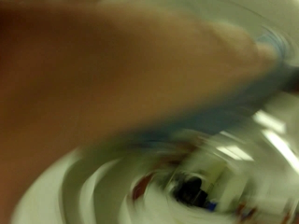
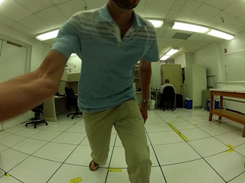
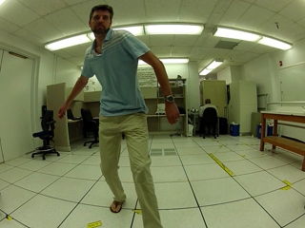
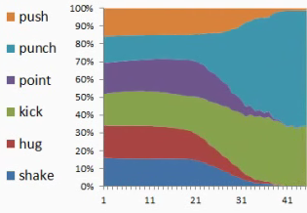
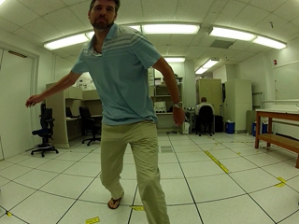
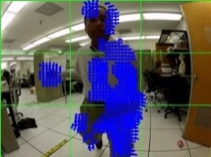
Conventional video classification framework
Video data
Semantic labels
Representation
Feature extraction
Classifier
n*m-D data (e.g., n = 320*240, m = 1000 frames)
s labels (e.g., s = 6)
k-D vector (e.g., 1000)
19

Slide 20
New ‘deep’ learning framework
Convolutional Neural Networks (CNN)
Video data
Semantic labels
Automatically learn millions of internal parameters from Data!
20

Slide 21
Traditional Recognition Approach
Hand-designed feature extraction
Trainable classifier
Image/ Video
Pixels
Object Class
Features are not learned
Trainable classifier is often generic (e.g. SVM)

Slide 22
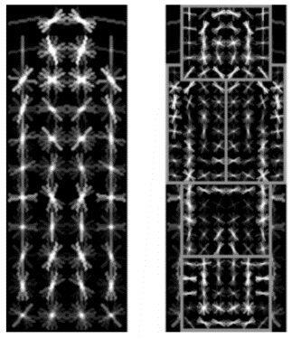
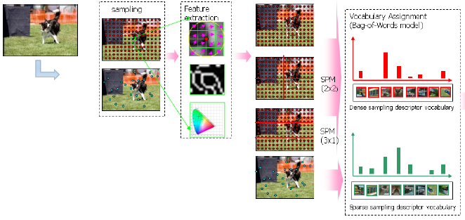

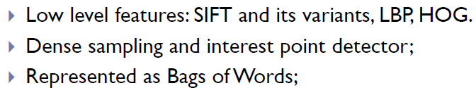
Traditional Recognition Approach
Features are key to recent progress in recognition
Multitude of hand-designed features currently in use
SIFT, HOG, ………….
Where next? Better classifiers? Or keep building more features?
Felzenszwalb, Girshick, McAllester and Ramanan, PAMI 2007
Yan & Huang (Winner of PASCAL 2010 classification competition)

Slide 23
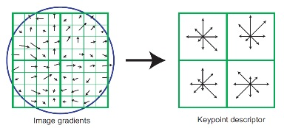
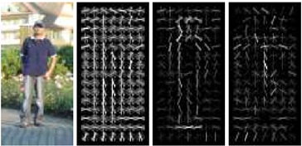
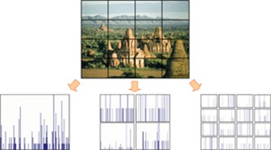


Features are key to recent progress in recognition
SIFT [Loewe IJCV 04]
HOG [Dalal and Triggs CVPR 05]
SPM [Lazebnik et al. CVPR 06]
DPM [Felzenszwalb et al. PAMI 10]
Color Descriptor [Van De Sande et al. PAMI 10]

Slide 24
What about learning the features?
Learn a feature hierarchy all the way from pixels to classifier
Each layer extracts features from the output of previous layer
Layers have (nearly) the same structure
Train all layers jointly
Image/ Video
Pixels
Layer 1
Layer 2
Layer 3
Simple Classifier
Notes:
Make clear that classic methods, e.g. convnets are purely supervised.

Slide 25
“Shallow” vs. “deep” architectures
Traditional recognition: “Shallow” architecture
Image/ Video
Pixels
Hand-designed feature extraction
Trainable classifier
Object Class
Deep learning: “Deep” architecture
Image/ Video
Pixels
Layer 1
Layer N
Simple classifier
…
Object Class

Slide 26



Biological neuron and Perceptrons
A biological neuron
An artificial neuron (Perceptron)
- a linear classifier
Notes:
At the majority of synapses, signals are sent from the axon of one neuron to a dendrite of another... All neurons are electrically excitable, maintaining voltage gradients across their membranes… If the voltage changes by a large enough amount, an all-or-none electrochemical pulse called an action potential is generated, which travels rapidly along the cell's axon, and activates synaptic connections with other cells when it arrives.

Slide 27


Simple, Complex and Hyper-complex cells
video
David H. Hubel and Torsten Wiesel
Suggested a hierarchy of feature detectors in the visual cortex, with higher level features responding to patterns of activation in lower level cells, and propagating activation upwards to still higher level cells.
David Hubel's Eye, Brain, and Vision
Notes:
D. Hubel and T. Wiesel (1959, 1962, Nobel Prize 1981)
Visual cortex consists of a hierarchy of simple, complex, and hyper-complex cells
In one experiment, done in 1959, they inserted a microelectrode into the primary visual cortex of an anesthetized cat. They then projected patterns of light and dark on a screen in front of the cat.

Slide 28


Hubel/Wiesel Architecture and Multi-layer Neural Network
Hubel and Weisel’s architecture
Multi-layer Neural Network
- A non-linear classifier
Notes:
simple cells: neurons that fire rapidly when presented with lines at one angle (orientation-sensitive). Respond to light patterns and dark patterns differently. Found all over the visual cortex.
with excitatory and inhibitory regions (represented by white and gray regions)
complex cells: detect edges regardless of where they were placed in the receptive field of the neuron and could preferentially detect motion in certain directions.
respond in a contrast-insensitive manner, i.e. the same cell might respond to a dark/light edge and a light/dark edge but only if it were at the proper orientation. Furthermore, the complex cells would respond to their edges in a larger region of the visual field. This suggested that complex cells received input from lower level simple cells by way of a receptive field.
"hypercomplex" cells: respond to more complex combinations of the simple features, for example to two edges at right angles to each other in a yet larger region of the visual field.
These studies showed how the visual system constructs complex representations of visual information from simple stimulus features.

Slide 29

Multi-layer Neural Network
A non-linear classifier
Training: find network weights w to minimize the error between true training labels and estimated labels
Minimization can be done by gradient descent provided f is differentiable
This training method is called back-propagation

Slide 30


Neocognitron [Fukushima, Biological Cybernetics 1980]
Deformation-Resistant Recognition
S-cells: (simple)
- extract local features
C-cells: (complex)
- allow for positional errors
Notes:
hierarchical, multilayered artificial neural network inspired by the model proposed by Hubel & Wiesel in 1959
The neocognitron is a natural extension of these cascading models. The neocognitron consists of multiple types of cells, the most important of which are called S-cells and C-cells.[2] The local features are extracted by S-cells, and these features' deformation, such as local shifts, are tolerated by C-cells. Local features in the input are integrated gradually and classified in the higher layers.[3] The idea of local feature integration is in several other models, such as LeNet and SIFT model.

Slide 31



Convolutional Neural Networks (CNN, Convnet)
Multi-layer Neural network with
Local connectivity
Shared weight parameters across spatial positions
Stack multiple stages of feature extractors
Higher stages compute more global, more invariant features
Classification layer at the end
LeNet-1 from 1993
Y. LeCun, L. Bottou, Y. Bengio, and P. Haffner, Gradient-based learning applied to document recognition, IEEE 86(11): 2278–2324, 1998.

Slide 32
Convolutional Neural Networks (CNN, Convnet)
Feed-forward feature extraction:
Convolve input with learned filters
Non-linearity
Spatial pooling
Normalization
Supervised training of convolutional filters by back-propagating classification error
Feature maps
Normalization
Spatial pooling
Non-linearity
Convolution (Learned)
Input Image

Slide 33





1. Convolution
Dependencies are local
Translation invariance
Few parameters (filter weights)
Stride can be greater than 1 (faster, less memory)
...
Input
Feature Map
Notes:
connect each neuron to only a local region of the input volume.

Slide 34



2. Non-Linearity
Per-element (independent)
Options:
Tanh
Sigmoid: 1/(1+exp(-x))
Rectified linear unit (ReLU)
Simplifies backpropagation
Makes learning faster
Avoids saturation issues → Preferred option

Slide 35



3. Spatial Pooling
Sum or max
Non-overlapping / overlapping regions
Role of pooling:
Invariance to small transformations
Larger receptive fields (see more of input)
Max
Sum
Notes:
Translation invariance

Slide 36


4. Normalization
Within or across feature maps
Before or after spatial pooling
Feature Maps After Contrast Normalization
Feature Maps

Slide 37


Compare: SIFT Descriptor
Lowe [IJCV 2004]
Image Pixels
Apply oriented filters
Spatial pool
(Sum)
Feature Vector
Normalize to unit length

Slide 38




Compare: Spatial Pyramid Matching
Lazebnik, Schmid, Ponce [CVPR 2006]
SIFT features
Filter with Visual Words
Take max VW response
Multi-scale spatial pool
(Sum)
Global image descriptor

Slide 39


Convnet Successes
Handwritten text/digits
MNIST (0.17% error [Ciresan et al. 2011])
Arabic & Chinese [Ciresan et al. 2012]
Simpler recognition benchmarks
CIFAR-10 (9.3% error [Wan et al. 2013])
Traffic sign recognition
0.56% error vs 1.16% for humans [Ciresan et al. 2011]
But until recently, less good at more complex datasets
Caltech-101/256 (few training examples)

Slide 40
ImageNet Challenge 2012
~14 million labeled images, 20k classes
Images gathered from Internet
Human labels via Amazon Turk
ImageNet Challenge: 1.2 million training images, 1000 classes
[Deng et al. CVPR 2009]
A. Krizhevsky, I. Sutskever, and G. Hinton, ImageNet Classification with Deep Convolutional Neural Networks, NIPS 2012

Slide 41

ImageNet Challenge 2012
“AlexNet”: Similar framework to LeCun’98 but:
Bigger model (7 hidden layers, 650,000 units, 60,000,000 params)
More data (10⁶ vs. 10³ images)
GPU implementation (50x speedup over CPU)
Trained on two GPUs for a week
Better regularization for training (DropOut)
A. Krizhevsky, I. Sutskever, and G. Hinton, ImageNet Classification with Deep Convolutional Neural Networks, NIPS 2012
Notes:
Two-GPU architecture

Slide 42

Object recognition from images
5-layer CNN for image classification
384*3*3*128 parameters
…
96*11*11*3 parameters
256*5*5*48 parameters
[Krizhevsky, Sutskever, Hinton, NIPS 2012]
42

Slide 43

Object recognition from images
5-layer CNN for image classification
[Krizhevsky, Sutskever, Hinton, NIPS 2012]
43

Slide 44


Using CNN for Image Classification
AlexNet
“car”
Fixed input size: 224x224x3

Slide 45
ImageNet Challenge 2012
Krizhevsky et al. -- 16.4% error (top-5)
Next best (non-convnet) – 26.2% error

Slide 46
ImageNet Challenge 2012-2014
Best non-convnet in 2012: 26.2%
Team | Year | Place | Error (top-5) | External data
SuperVision – Toronto (7 layers) | 2012 | - | 16.4% | no
SuperVision | 2012 | 1st | 15.3% | ImageNet 22k
Clarifai – NYU (7 layers) | 2013 | - | 11.7% | no
Clarifai | 2013 | 1st | 11.2% | ImageNet 22k
VGG – Oxford (16 layers) | 2014 | 2nd | 7.32% | no
GoogLeNet (19 layers) | 2014 | 1st | 6.67% | no
Human expert* |  |  | 5.1%
Team | Method | Error (top-5)
DeepImage - Baidu | Data augmentation + multi GPU | 5.33%
PReLU-nets - MSRA | Parametric ReLU + smart initialization | 4.94%
BN-Inception ensemble - Google | Reducing internal covariate shift | 4.82%
Notes:
Best non-convnet in 2012: 26.2%

Slide 47

Deep Learning 2014
22-layer CNN for image classification (Google – ImageNet Challenge 2014 winner)
[Szegedy et al., ImageNet 2014, CVPR 2015]
47

Slide 48

Deep Learning 2015
What happened in ImageNet Challenge 2015? – MSR Asia
Error: 3.57%
48

Slide 49
Understanding and Visualizing CNN
Visualize input pattern using deconvnet
Individual neuron activation
Fooling CNNs

Slide 50

Map activation back to the input pixel space
What input pattern originally caused a given activation in the feature maps?
Visualizing and Understanding Convolutional Networks [Zeiler and Fergus, ECCV 2014]

Slide 51

Layer 1
Visualizing and Understanding Convolutional Networks [Zeiler and Fergus, ECCV 2014]
Notes:
Patches from validation images that give maximal activation of a given feature map

Slide 52

Layer 2
Visualizing and Understanding Convolutional Networks [Zeiler and Fergus, ECCV 2014]

Slide 53

Layer 3
Visualizing and Understanding Convolutional Networks [Zeiler and Fergus, ECCV 2014]

Slide 54

Layer 4 and 5
Visualizing and Understanding Convolutional Networks [Zeiler and Fergus, ECCV 2014]

Slide 55

Fooling CNNs
Intriguing properties of neural networks [Szegedy ICLR 2014]

Slide 56
What is going on?
Recall gradient descent training: modify the weights to reduce classifier error
Adversarial examples: modify the image to increase classifier error
Explaining and Harnessing Adversarial Examples [Goodfellow ICLR 2015]
http://karpathy.github.io/2015/03/30/breaking-convnets/

Slide 57

What is going on?
x
Explaining and Harnessing Adversarial Examples [Goodfellow ICLR 2015]
http://karpathy.github.io/2015/03/30/breaking-convnets/

Slide 58

Fooling CNNs
Deep Neural Networks are Easily Fooled: High Confidence Predictions for Unrecognizable Images [Nguyen et al. CVPR 2015]

Slide 59

Images that both CNN and Human can recognize
Deep Neural Networks are Easily Fooled: High Confidence Predictions for Unrecognizable Images [Nguyen et al. CVPR 2015]

Slide 60

Direct Encoding
Deep Neural Networks are Easily Fooled: High Confidence Predictions for Unrecognizable Images [Nguyen et al. CVPR 2015]

Slide 61

Indirect Encoding
Deep Neural Networks are Easily Fooled: High Confidence Predictions for Unrecognizable Images [Nguyen et al. CVPR 2015]

Slide 62
Beyond classification
Detection
Segmentation
Regression
Pose estimation
Matching patches
Synthesis
and many more…

Slide 63
Deep learning features?
Convolutional Neural Networks (CNN)
Video data
Semantic labels
Steal these!
Feature extraction
Classification
63

Slide 64

R-CNN: Regions with CNN features
Trained on ImageNet classification
Finetune CNN on PASCAL
RCNN [Girshick et al. CVPR 2014]

Slide 65


Labeling Pixels: Semantic Labels
Fully Convolutional Networks for Semantic Segmentation [Long et al. CVPR 2015]

Slide 66

Labeling Pixels: Edge Detection
DeepEdge: A Multi-Scale Bifurcated Deep Network for Top-Down Contour Detection
[Bertasius et al. CVPR 2015]

Slide 67

CNN for Regression
DeepPose [Toshev and Szegedy CVPR 2014]

Slide 68





CNN as a Similarity Measure for Matching
Stereo matching [Zbontar and LeCun CVPR 2015]
Compare patch [Zagoruyko and Komodakis 2015]
FaceNet [Schroff et al. 2015]
Match ground and aerial images
[Lin et al. CVPR 2015]
FlowNet [Fischer et al 2015]

Slide 69



CNN for Image Restoration/Enhancement
Super-resolution [Dong et al. ECCV 2014]
Non-blind deconvolution [Xu et al. NIPS 2014]
Non-uniform blur estimation [Sun et al. CVPR 2015]

Slide 70

CNN for Image Generation
Learning to Generate Chairs with Convolutional Neural Networks [Dosovitskiy et al. CVPR 2015]

Slide 71

CNNs for videos
Two-stream CNNs (now Google DeepMind)
Multi-frame optical flows
11 frames
[Simonyan & Zisserman NIPS 2014] [Feichtenhofer et al., CVPR 2016]
71

Slide 72

CNNs for videos (2)
Facebook C3D
Spatio-temporal filters for short video segments (e.g., 16 frames)
ActivityNet challenge provides pre-extracted C3D as its default features
[Tran et al., ICCV 2015]
72

Slide 73

Video representation
Many conventional approaches simply took max/mean of per-frame CNN (e.g., two-stream) representations
Previous

Slide 74

Video representation
Many conventional approaches simply took max/mean of per-frame CNN (e.g., two-stream) representations
Previous
[Ryoo et al., CVPR 2015]

Slide 75






Temporal structure in human activities
More recently, researchers are looking at learning longer-term temporal structure in activity videos (while using CNNs).
Activities are composed of multiple sub-events
Push-up
Somersault
75

Slide 76

End-to-end temporal structure learning
Learning/mining latent sub-events from human activity videos
We proposed a new approach of learning ‘temporal’ attention filters on top of convolutional neural networks
[Piergiovanni*, Fan*, Ryoo, AAAI 2017]
76

Slide 77



Temporal attention filters
Each temporal filter has P Gaussian receptors with in it
77

Slide 78
Demo video – CNN for robotics
https://youtu.be/OCnp_eduA6Q
[Lee & Ryoo, arXiv 1703.01040]

Slide 79
CNN packages
Cuda-convnet (A. Krizhevsky, Google)
Caffe (Y. Jia, Berkeley)
Replacement of deprecated Decaf
Overfeat (NYU)
Torch (Facebook)
MatConvNet (A. Vedaldi, Oxford)
Python libraries
Theano and TensorFlow (from Google)

Slide 80
Resources
http://deeplearning.net/
https://github.com/ChristosChristofidis/awesome-deep-learning
http://cs231n.stanford.edu/syllabus.html

Slide 81
Questions?
See you at the Final Exam!

